Slide 1
Recovering and Verifying Architecture Through DSM

Slide 2
Design Structure Matrix
A DSM displays the relationships between components of a system in a compact, visual, and analytically advantageous format.
A DSM is a square matrix with identical row and column labels.
Reading across a row reveals what other elements the element in that row provides to; scanning down a column reveals what other elements the element in that column depends on. That is, reading down a column reveals input sources, while reading across a row indicates output sinks.

Slide 3
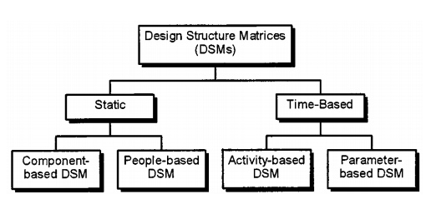

Slide 4
There are two main categories of DSMs: static and time-based.
Static DSMs represent system elements existing simultaneously, such as components of a product architecture or groups in an organization.
Static DSMs are usually analyzed with clustering algorithms.
In time-based DSMs, the ordering of the rows and columns indicates a flow through time: upstream activities in a process precede downstream activities, and terms like “feedforward” and “feedback” become meaningful when referring to interfaces.
Time-based DSMs are typically analyzed using sequencing algorithms.

Slide 5
MODELING SYSTEM ARCHITECTURE WITH COMPONENT-BASED DSMS
The motivation :
Product architecture is the arrangement of functional elements into physical chunks that become the building blocks for a product or family of products.
Chunks should implement one or a few functions entirely, and interactions between chunks should be well defined.
Modular system architectures have advantages in simplicity and reusability for a product family or platform.

Slide 6
An innovative product architecture can be a source of competitive advantage for product development firms.
The relationships among elements are what give systems their added value, and, furthermore, that the greatest leverage in systems architecting is at the interfaces.

Slide 7
Using DSM
A DSM can represent a system architecture in terms of the relationships between its constituent components.
Such a model informs system decomposition into subsystems.
Intelligent decomposition or partitioning is important in managing system complexity.

Slide 8
In general, the system engineering exercise involves the following three steps:
1) decompose the system into elements;
2) understand and document the interactions between the elements (i.e., their integration);
3) analyze potential reintegration of the elements via clustering (integration analysis)

Slide 9
A component-based DSM documents interactions among elements in a system architecture.
A quantification scheme facilitates weighting interactions relative to each other. Off-diagonal square marks in the DSM are replaced by a number (coupling coefficient)—e.g., an integer -2,-1 , 0, 1, or 2.

Slide 10
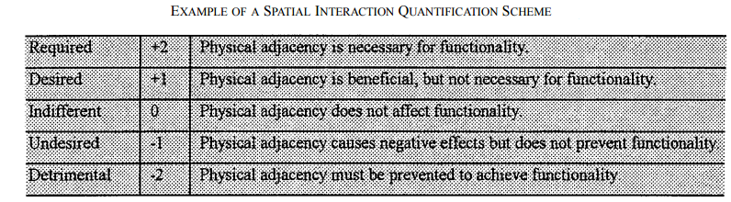

Slide 11
Integration analysis—via the clustering of off-diagonal elements by reordering the rows and columns of the DSM—can provide new insights into system decomposition and integration.
By reordering rows and columns, a clustering algorithm seeks a DSM configuration that optimizes an objective function.
A clustering algorithm should account for the importance of both precluding negative relationships and ensuring positive ones.
After clustering analysis, any interactions exogenous to the clusters should be noticed as interfaces where special attention and verification may be required.

Slide 12
We can use a component-based DSM to reveal and explore alternative architectures
To improve the quality of the resulting product design and to ease the substantial coordination demands that are required when subsystems interact.
Using a distance penalty algorithm or by examination, the system can be clustered into subsystems on the rationale behind architecting decisions.
Integration analysis also supports modularization, which, in turn, enables product platforms and other advantageous approaches to product development.

Slide 13
Tool used: Lattix
Field of Application
Lattix has been primarily used in the field of software/IT systems engineering across many industries, however it has also been applied to a wide variety of complex systems that include software, hardware, activities/processes, and organizations. Users include architects, engineers, and quality/test staff as well as managers.

Slide 14
Supported tasks
Create a system blueprint by mapping dependencies across the various domains of the system
Analyze, optimize, and specify the system architecture through the DSM, diagrams, and dependency rules
Identify dependencies which violate the architecture
Identify and explore opportunities to improve the modularity of the system
Measure quality with key metrics and track changes to the system architecture over time
Assess the impact and risk of proposed changes to the system

Slide 15
Tool used: NDepends
Tool supports static visualizing dependencies between assemblies and classes through a dependency structure matrix (DSM).
A DSM gives you the ability to show the architecture of your application.
Cyclic dependencies will also be visible in a DSM.
It is similar to Lattix in terms of functionality, though it specifically targets .Net and has Visual Studio Integration.

Slide 16
Other Research Tools Used
Antares DSM:
Antares DSM is a software tool to manipulate all types of DSMs. In Antares DSM is possible create, see, and execute functions to optimize the DSM projects.
Cambridge Advanced Modeller (by the Engineering Design Center, University of Cambridge):
Cambridge Advanced Modeller (previously known as P3) is a software tool for building and analysing models of complex systems. Its strength lies in customisability, allowing users to address specific modelling needs.

Slide 17
DeMAID
Developed by the NASA Langley Research Center, DeMAID is a knowledge-based software tool for ordering the sequence of design processes and identifying a possible multilevel structure for a design cycle. DeMAID uses and displays the processes in a Design Structure Matrix notation.
Excel Macros for Partitioning and Simulation
A DSM Excel macro that performs partitioning, tearing, banding, and simulation.

